Slide 1
Python workshop 1
BRANDON FREECK
BGFREECK@NEIU.EDU

Slide 2
Who am i?
Brandon Freeck
Email: bgfreeck@neiu.edu
Phone: 847-345-5991
CS Student, Junior
Been fiddling with tech most of my life
Over the past year or so, I started looking into using Python to whip up quick projects that would come to me now and then
I’ve picked up a few things in doing so, and would like to share them with you

Slide 3
You are not the only ones learning
I’ve never hosted something like this before, so I’m learning as we go just as much as you are
Feel free to stop me if I’m not clear enough, talking too fast, not talking loud enough, or for any reason at all really
We will definitely run into things later on that I haven’t directly worked with. But part of being a good programmer is learning how to learn, I will show you how I go about researching and implementing new concepts to my projects

Slide 4
Install Python 3.6 and geany
https://www.python.org/downloads/
https://www.geany.org/Download/Releases
Install Python first, afterwards install Geany
We will test Python and Geany installs after everyone has completed installation

Slide 5
Testing Python – Open the CLI for your OS
Windows: Open Command Line by pressing Windows Key + R and typing in “cmd”
OSX/MacOS: Open terminal via spotlight or Applicatons folder
Linux: I shouldn’t have to tell you how to do this

Slide 6
Testing python – test path
Once command line/terminal has been opened, we are going to make sure our system recognizes python in the path
Type “python --version” or “python -V” to see the version of Python printed in the window
If this command resolves and succeeds in printing the version of Python, then your system is ready to start running scripts

Slide 7
Geany
Open Geany on your machine
You will see a new file “untitled”
Geany is a text editor that can be used for a multitude of languages
Geany is cross platform, and has auto formatting, coloring, and syntax correction features

Slide 8
Geany
Save file as “untitled.py” and Geany will detect that it is a python script and begin to color and auto format code
Clicking the button that looks like two gears will compile and run our script in a command line interface
We can also use Geany to just compile the script, and make it ready for later execution. However, this isn’t something we’ll use very much if at all

Slide 9
We did it
Let’s start looking at some of the concepts you already know, and how they’re handled in Python
Variables – Type does not need to be declared
Data Types: Numbers, Strings, List, Tuple, Dictionary
Arithmetic Operators: +, -, *, /, %, **, //
** is exponential, // is floor division

Slide 10
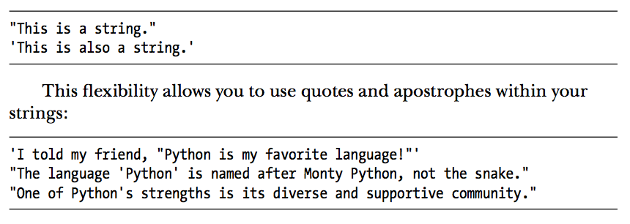
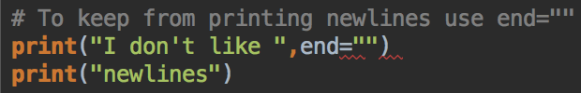
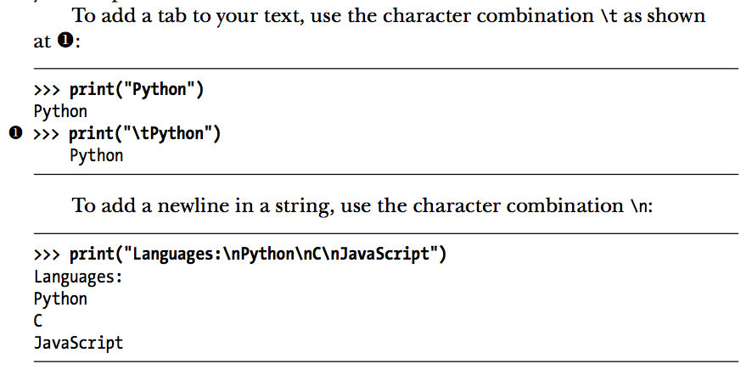
Strings
You can use “\” as an escape to insert characters if you need to
Triple quoted “Strings” are used as multi line comments. They’re still technically strings but the Python interpreter ignores them
Can use .title(), .upper(), .lower() as methods
Strings more or less behave like you would expect them to coming from Java
You can concatenate to make new strings, or print those concatenated strings

Slide 11
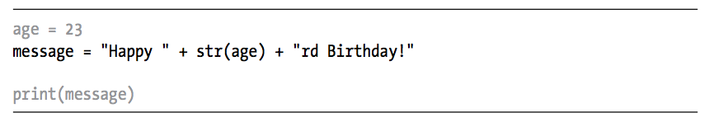
Numbers
Python is lazy about implicitly casting Ints in strings
You have to account for this by surrounding the int with “str()”
This can print “21rd Birthday!”, let’s quickly make a script that will check the age number and modify the output accordingly

Slide 12
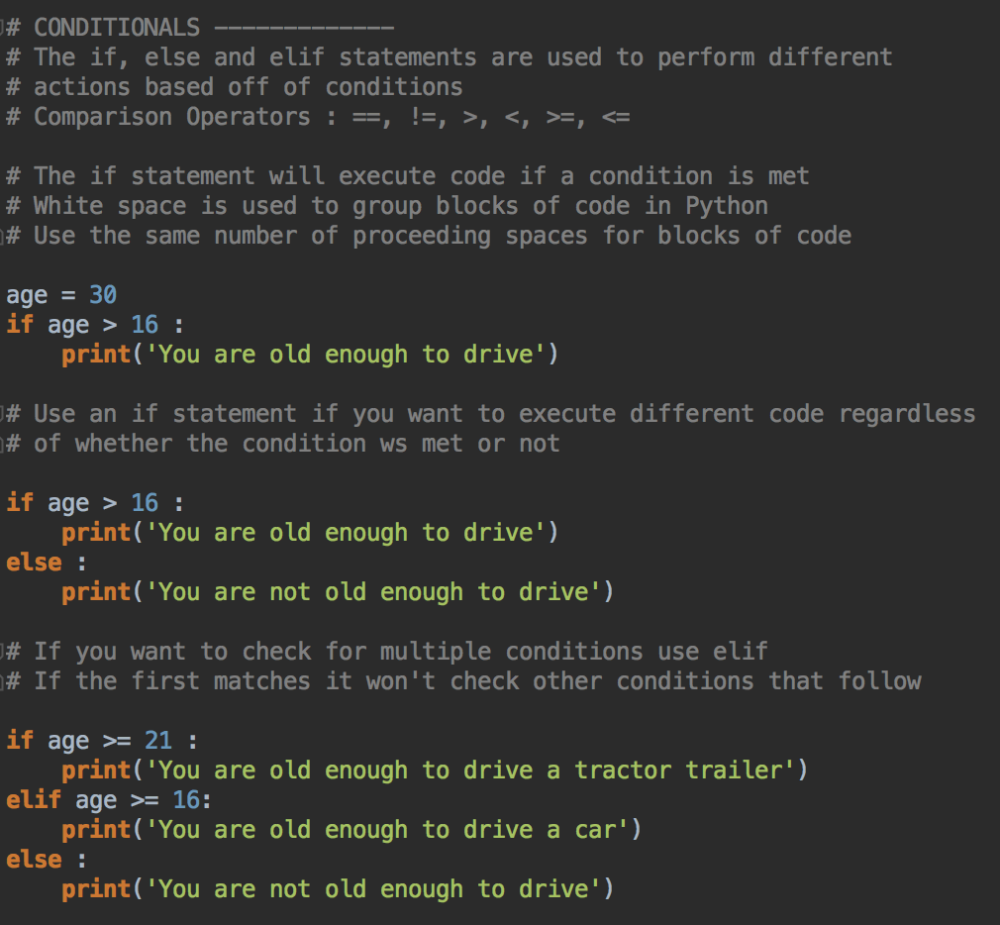
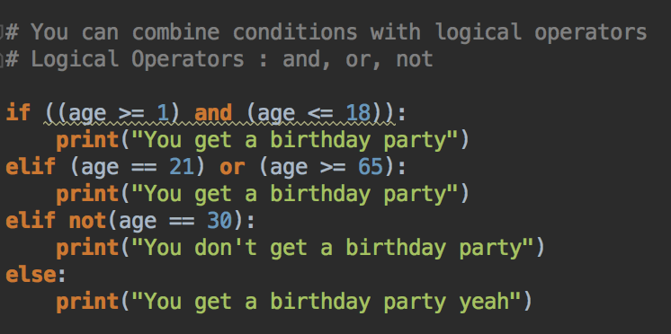
Conditionals & If, Else, Elif

Slide 13
The “zen of python”
Python was made with the intention that there would be one way to solve a problem, and to focus on avoiding complexities introduced when a language is made overly flexible
Key Points:
Beautiful is better than ugly
Simple is better than complex
Complex is better than complicated
Readability counts
There should be one obvious way to do it
Now is better than never
This is SUPER important
Programming is a lot more fun when you’re making projects
Get code working, improve it later
You’ll learn a lot more if you just dive in

Slide 14
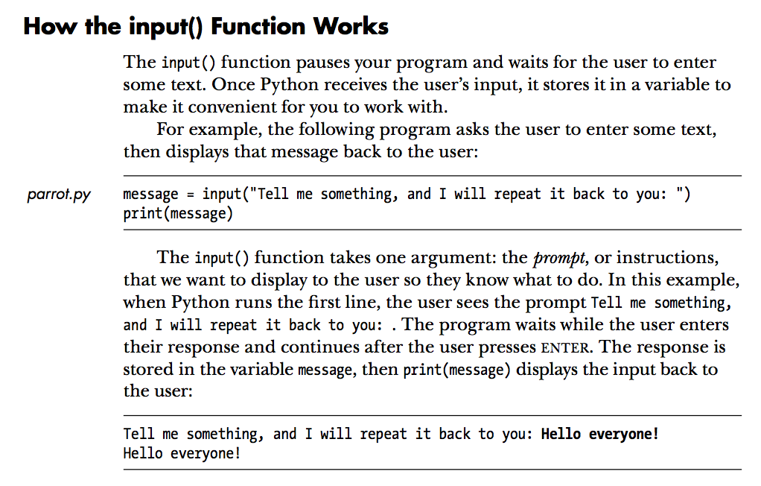
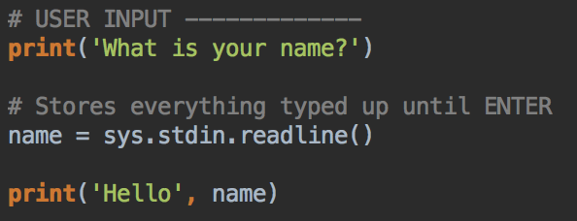
User input
Input function essentially combines print and Scanner.input() from Java
It also doesn’t require an import
You can however import sys and use that to capture input separately

Slide 15
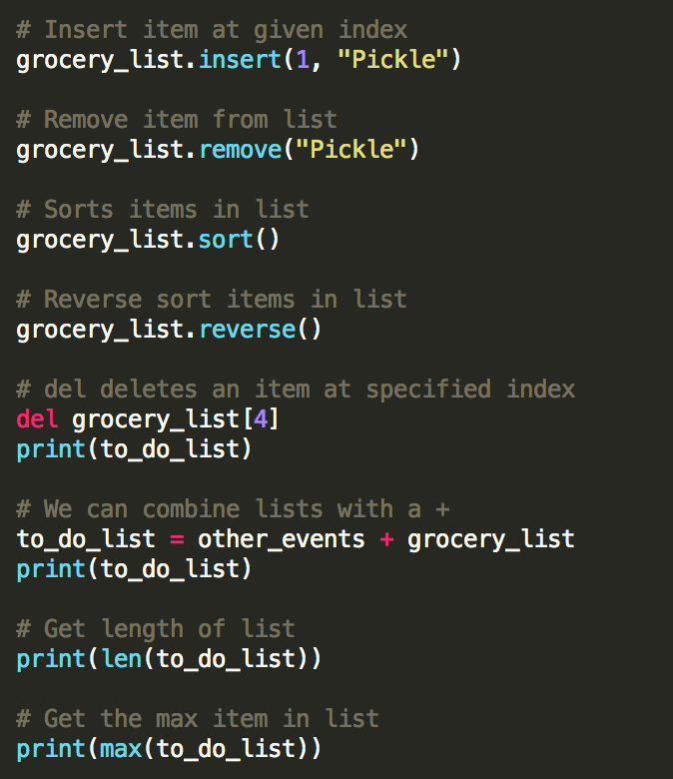
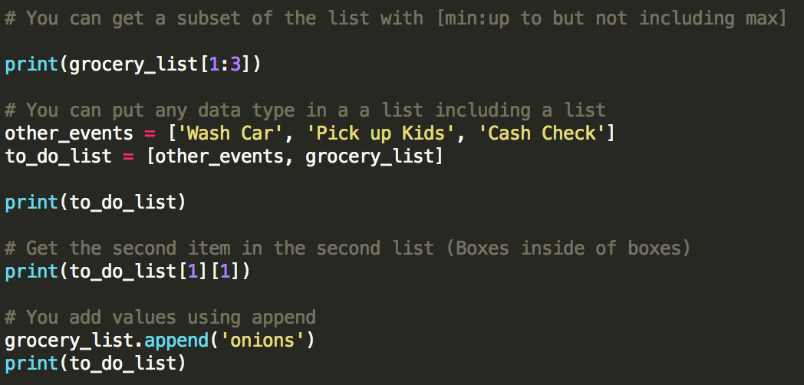
Lists
Lists are more or less arrays
You can do some neat things with lists

Slide 16
For loops
For loops in python are awesome
Easy to use, no redundant loop creation like Java

Slide 17
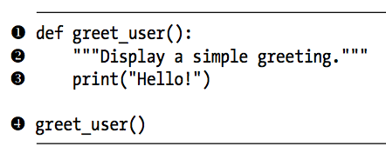
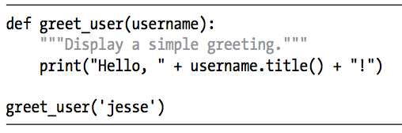
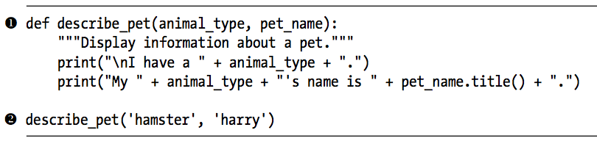
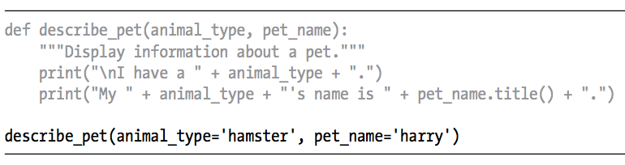
Functions (methods)
Functions function (heh) pretty much exactly like methods in Java
Arguments can be passed positionally (like Java) or keyword (“fancy” Python)

Slide 18
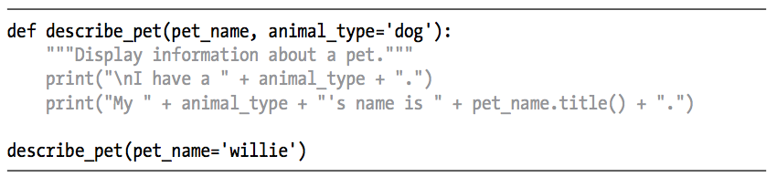
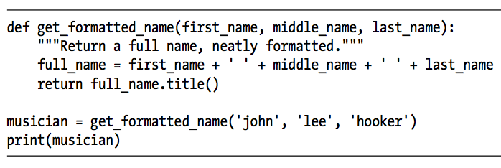
More functions
Can set default values in methods
”return” statements work as you would expect
You can use default arguments of an empty value to make optional arguments
Can add arbitrary arguments as well
You can place funtions in a separate file
Unlike java, you need to import these to use them

Slide 19
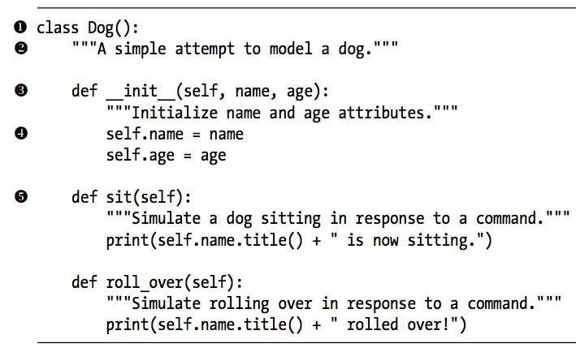
Classes
Unsurprisingly, these function similarly to classes in Java
Attributes can be modified directly, or by a set method
Inheritance, child classes, super, and all that exists as well, but I won’t be covering it
Can import entire module that contains class, or just the class from said module
Same thing appllies when importing modules containing functions

Slide 20
So it’s finally time to make something
At this point, you’ve learned essentially everything that I know about python
It may not seem like a lot, but when you combine aspects and operations and keep stacking them, you can do a lot of powerful things
Just for simplicity’s sake, we’re going to make a DnD 5e character creation program
This will use everything we’ve learned in all the sessions, including Functions and Classes

